Slide 1
CS 347 ARL List
Farzad Vafaee (FHV67)
Jae Lim (JHL2329)

Slide 2
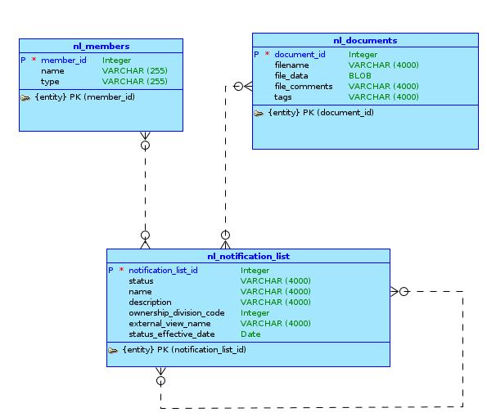
Conceptual Model

Slide 3
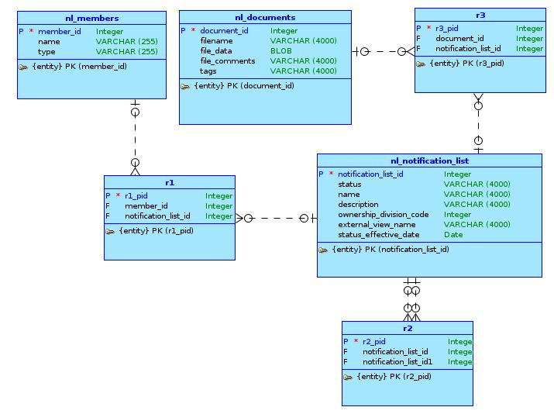
Logical Model

Slide 4
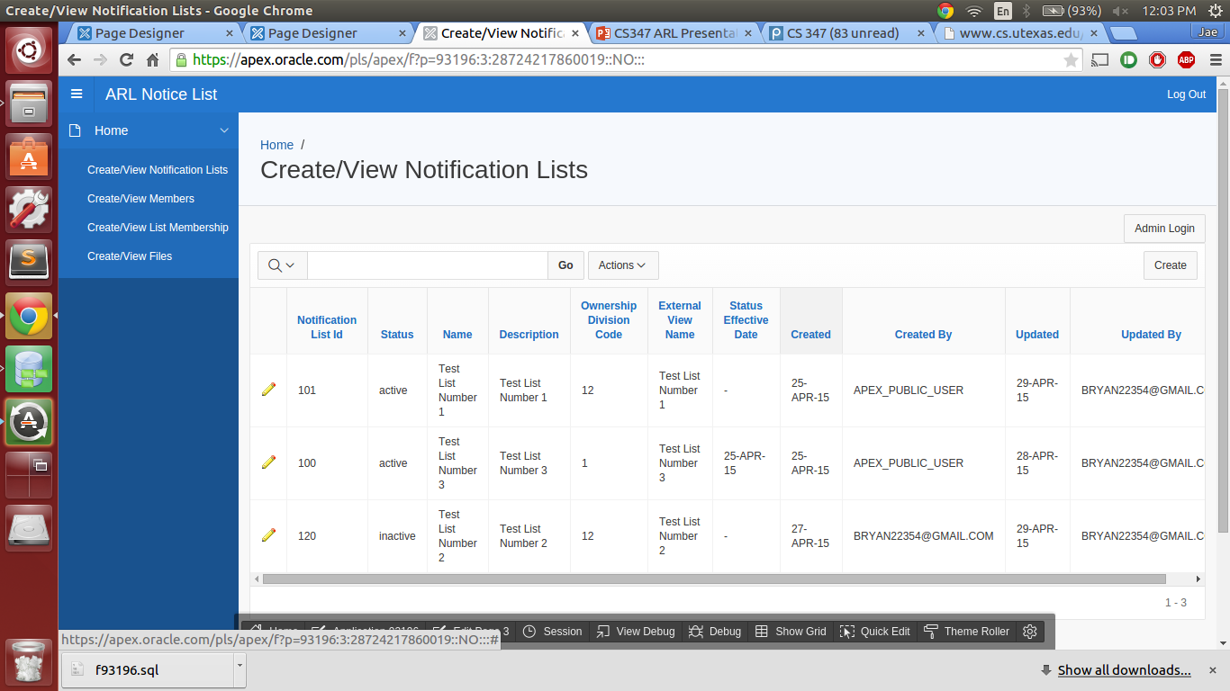
Screenshots

Slide 5
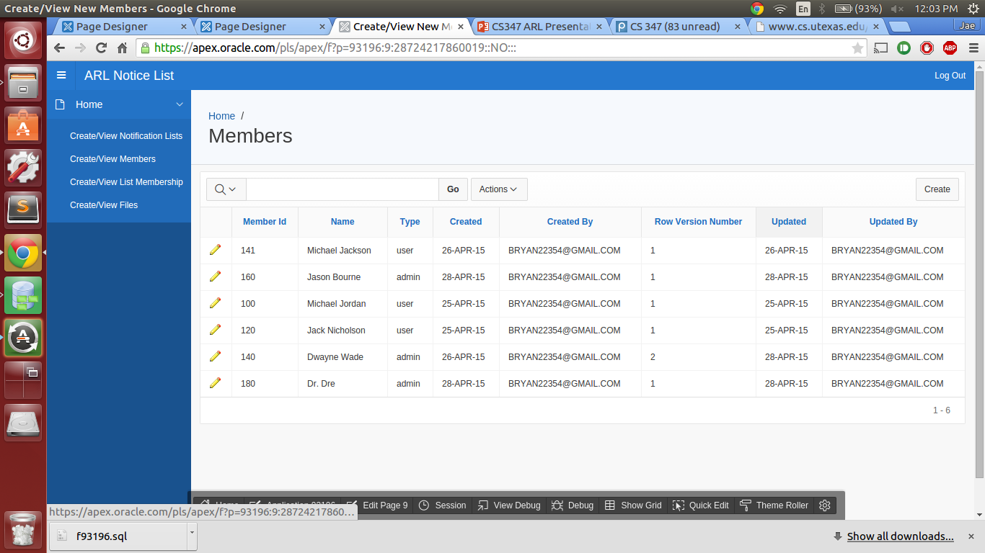

Slide 6
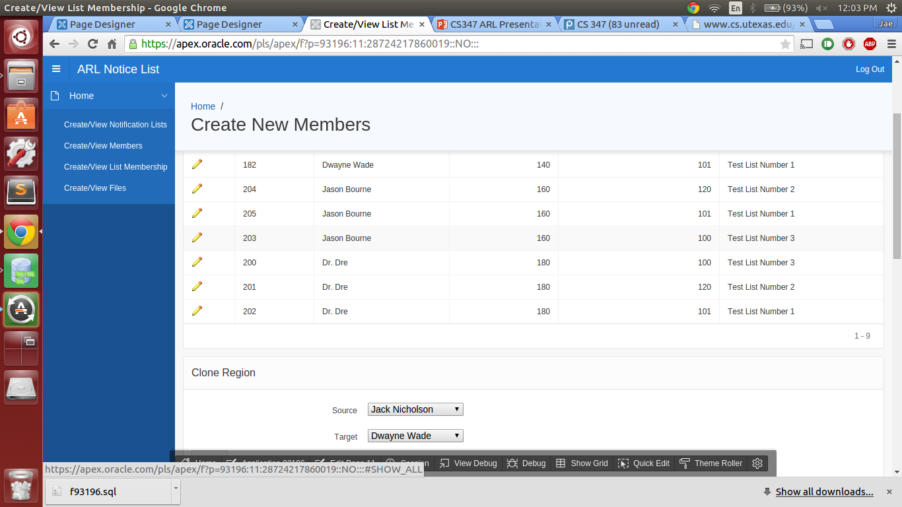

Slide 7


